Slide 1
Data Mining & Knowledge Discovery
IME 672
Lecture 5

Slide 2
Classification: Basic Concepts

Slide 3
Classification
A form of data analysis that extracts model or classifier to predict class labels
class labels categorical (discrete or nominal)
classifies data based on training set and values in a classifying attribute, and uses it in classifying new data
Numeric Prediction
models continuous-valued functions, i.e., predicts unknown or missing values
Typical applications
Credit/loan approval: loan application is “safe” or “risky”
Medical diagnosis: tumor is “cancerous” or “benign”
Fraud detection: transaction is “fraudulent”

Slide 4
Supervised vs. Unsupervised Learning
Supervised learning (classification)
Supervision: The training data is accompanied by labels indicating the class of the observations
New data is classified based on the training set
Unsupervised learning (clustering)
The class labels of training data is unknown
Given a set of observations, the aim is to establish existence of classes or clusters in the data

Slide 5
Classification— Two-Step Process
Model construction: Describe a set of predetermined classes
Each tuple is assumed to belong to a predefined class, as determined by the class label attribute
The model is represented as classification rules, decision trees, or mathematical formulae
Model usage: Classify future or unknown objects
Estimate accuracy of the model
The known label of test sample is compared with the classified result from the model
Accuracy = percentage of test set samples that are correctly classified by the model
Test set is independent of training set (otherwise overfitting)
If the accuracy is acceptable, use the model to classify new data

Slide 6
Phase 1: Model Construction
Classification
Algorithms
Training
Data
Classifier
(Model)
IF rank = ‘professor’
OR years > 6
THEN tenured = ‘yes’

Slide 7
Phase 2: Model Usage
IF rank = ‘professor’
OR years > 6
THEN tenured = ‘yes’
Classifier
Testing
Data
Unseen Data
(Jeff, Professor, 4)
Tenured?

Slide 8
Decision Tree Induction
Decision tree: a flowchart-like tree structure where each
internal node (nonleaf node): a test on an attribute,
branch: an outcome of the test, and
leaf node (or terminal node): class label
Decision tree induction is the learning of decision trees from class-labeled training tuples
ID3 (Iterative Dichotomiser), C4.5, Classification and Regression Trees (CART)

Slide 9
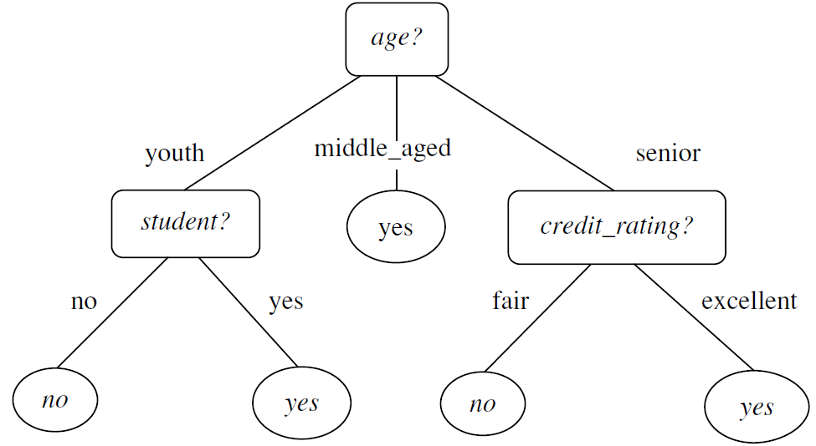
Decision Tree: Example

Slide 10
Algorithm
Generate_decision_tree: Generate a decision tree from the training tuples of data partition, D
Input:
Data partition, D, which is a set of training tuples and their associated class labels;
attribute_list, the set of candidate attributes;
Attribute_selection_method( ): determine the splitting criterion that “best” partitions the data tuples into individual classes. Consists of a splitting attribute and, possibly, either a split-point or splitting subset
Output: A decision tree

Slide 11
Method
create a node N;
if tuples in D are all of the same class, C, then
return N as a leaf node labeled with the class C;
if attribute_list is empty then
return N as a leaf node labeled with the majority class in D;
apply Attribute_selection_method(D, attribute_list) to find the “best” splitting criterion;
label node N with splitting_criterion;
if splitting_attribute is discrete-valued and multiway splits allowed then // not restricted to binary trees
attribute_list = attribute_list – splitting_attribute; // remove splitting attribute

Slide 12
Method
for each outcome j of splitting_criterion
// partition the tuples and grow subtrees for each partition
let D_{j} be the set of data tuples in D satisfying outcome j;
if D_{j} is empty then
attach a leaf labeled with the majority class in D to node N;
else attach the node returned by Generate_decision_tree(D_{j} ,attribute_list) to node N;
endfor
return N;

Slide 13
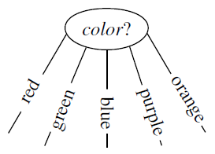
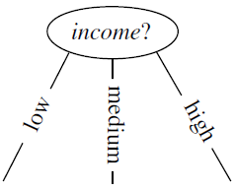
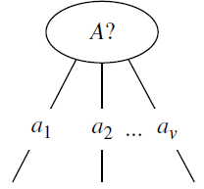
Splitting Attribute: Types
discrete-valued

Slide 14
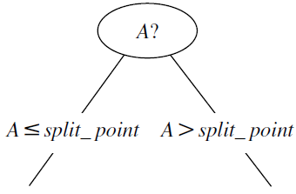
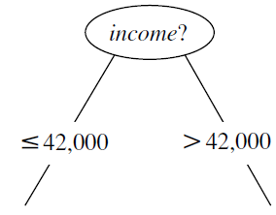
Splitting Attribute: Types
continuous-valued

Slide 15
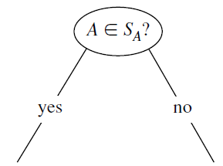
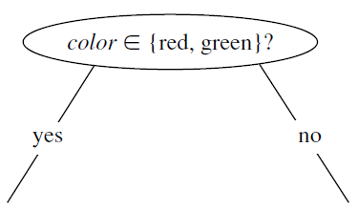
Splitting Attribute: Types
discrete-valued and a binary tree must be produced

Slide 16
Terminating conditions
All the tuples in partition D (represented at node N) belong to the same class (steps 2 and 3)
There are no remaining attributes on which the tuples may be further partitioned (step 4). In this case, majority voting is employed (step 5). This involves converting node N into a leaf and labeling it with the most common class in D
There are no tuples for a given branch, that is, a partition D_{j} is empty (step 12). In this case, a leaf is created with the majority class in D (step 13)

Slide 17
Attribute Selection Measures
An attribute selection measure is a heuristic for selecting the splitting criterion that “best” separates a given data partition
Pure partition: A partition is pure if all the tuples in it belong to the same class
split up the tuples according to mutually exclusive outcomes of the splitting criterion
Popular measures
information gain, gain ratio, Gini index

Slide 18
Notations
D: data partition, a training set of class-labeled tuples
m: distinct values of class label attribute defining m distinct classes, C_{i} (i = 1,…,m)
C_{i,D}: set of tuples of class C_{i} in D
|D_{j}|: number of tuples in D_{j}
|C_{i,D} |: number of tuples in C_{i,D}

Slide 19
Information Gain
ID3 uses information gain as its attribute selection measure
Node N represents tuples of partition D
Attribute with the highest information gain is chosen as the splitting attribute for node N
Objective: to partition on an attribute that would do the “best classification,” so that the amount of information still required to finish classifying the tuples is minimal
Minimize expected number of tests needed to classify a given tuple and guarantee a simple tree is found

Slide 20
Information Gain
Let p_{i} be the probability that an arbitrary tuple in D belongs to class C_{i}, estimated by |C_{i, D}|/|D|
Expected information (entropy) needed to classify a tuple in D:
Original information required based on just the proportion of classes
How much more information would we still need (after the partitioning) to arrive at an exact classification?
Information needed (after using A to split D into v partitions) to classify D:

Slide 21
Information Gain
Info_{A}(D) is the expected information required to classify a tuple from D based on the partitioning by A
The smaller the expected information (still) required, the greater the purity of the partitions
Information gained by branching on attribute A
Expected reduction in the information requirement caused by knowing the value of A

Slide 22
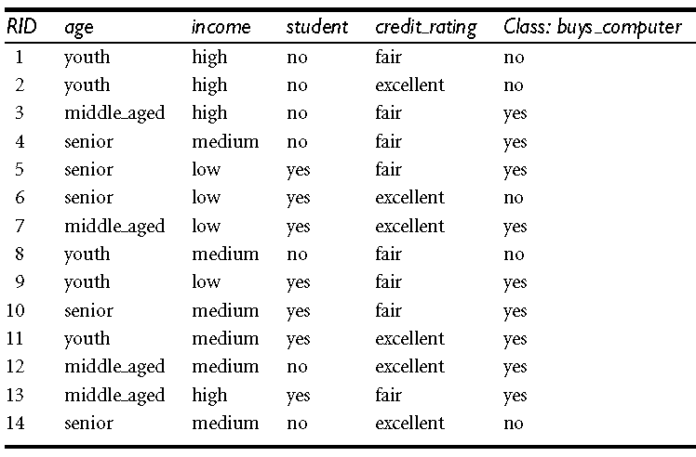
Example

Slide 23
Information Gain
Continuous-Valued Attribute, A
Must determine the best split point for A
Sort the value A in increasing order
Typically, the midpoint between each pair of adjacent values is considered as a possible split point
(a_{i}+a_{i+1})/2 is the midpoint between the values of a_{i} and a_{i+1}
Given v values of A, then v-1 possible splits are evaluated
For each possible split-point for A, evaluate Info_{A}(D), where the number of partitions is two, that is, v=2 (or j=1, 2)
The point with the minimum expected information requirement for A is selected as the split point for A
Split:
D₁ is the set of tuples in D satisfying A ≤ split-point, and D₂ is the set of tuples in D satisfying A > split-point

Slide 24
Gain Ratio
Information gain measure is biased toward tests with many outcomes
C4.5 (a successor of ID3) uses gain ratio to overcome the problem (normalization to information gain)
GainRatio(A) = Gain(A)/SplitInfo(A)
The attribute with the maximum gain ratio is selected as the splitting attribute

Slide 25
Gini Index
Used in CART, IBM IntelligentMiner
Gini index is defined as
The Gini index considers a binary split for each attribute
Let A be a discrete-valued attribute having v distinct values
To determine the best binary split on A, examine all the possible subsets that can be formed using known values of A

Slide 26
Gini Index
Compute a weighted sum of the impurity of each resulting partition
Subset that gives the minimum Gini index for that attribute is selected as its splitting subset
Reduction in impurity that would be incurred by a binary split on a discrete- or continuous-valued attribute A is
Attribute that maximizes the reduction in impurity (or, equivalently, has the minimum Gini index) is selected as the splitting attribute

Slide 27
Comparing Attribute Selection Measures
Information gain:
biased towards multivalued attributes
Gain ratio:
tends to prefer unbalanced splits in which one partition is much smaller than the others
Gini index:
biased to multivalued attributes
has difficulty when # of classes is large
tends to favor tests that result in equal-sized partitions and purity in both partitions

Slide 28
Other Attribute Selection Measures
CHAID: a popular decision tree algorithm, measure based on χ² test for independence
C-SEP: performs better than info. gain and gini index in certain cases
G-statistic: close approximation to χ² distribution
MDL (Minimal Description Length) principle
least bias toward multivalued attributes
The best tree is the one that requires the fewest # of bits to both (1) encode the tree, and (2) encode the exceptions to the tree
Multivariate splits (partition based on multiple variable combinations)
CART: finds multivariate splits based on a linear comb. of attributes
Which attribute selection measure is the best?
Most give good results, none is significantly superior than others

Slide 29
Decision Tree Pruning
A decision tree may grow long / branch too many due to noise or outliers – overfitting
Poor accuracy for unseen samples
Pruning - remove the least-reliable branches
Pruned trees
smaller
less complex
easier to comprehend
usually faster and better at correctly classifying independent test data

Slide 30
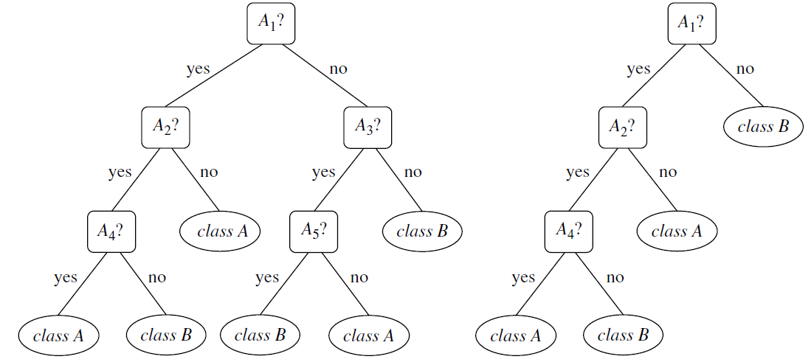
Decision Tree Pruning
Unpruned
Pruned

Slide 31
Decision Tree Pruning
Two approaches
Prepruning
Tree is “pruned” by halting its construction early
Do not split a node if this would result in the goodness measure falling below a threshold
Upon halting, the node becomes a leaf
Leaf may hold the most frequent class among the subset tuples
Difficult to choose an appropriate threshold

Slide 32
Decision Tree Pruning
Postpruning
Remove subtrees from a “fully grown” tree
Replace the subtree with a leaf
cost complexity pruning algorithm used in CART
A function of number of leaves in the tree and error rate
For each internal node, N, compute cost complexities with and without subtree at N
Subtree is pruned if it results in a smaller cost complexity

Slide 33
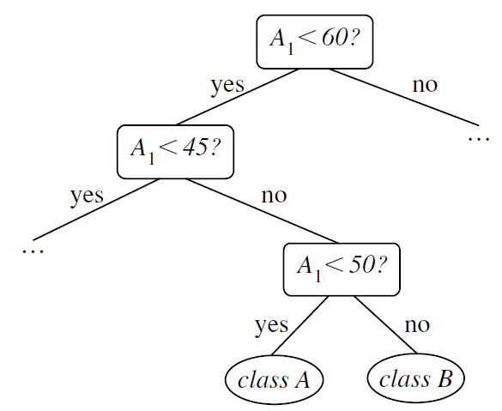
Other Issues
Repetition: occurs when an attribute is repeatedly tested along a given branch of the tree

Slide 34
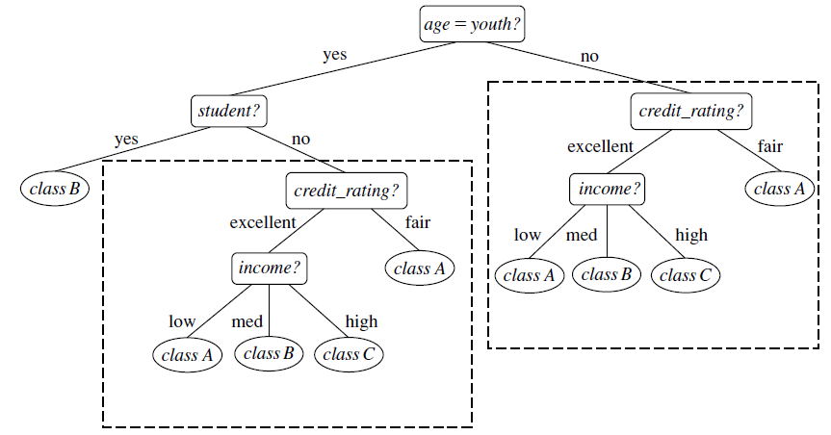
Other Issues
Replication: duplicate subtrees exist within the tree
Multivariate splits can prevent these problems

